Slide 1
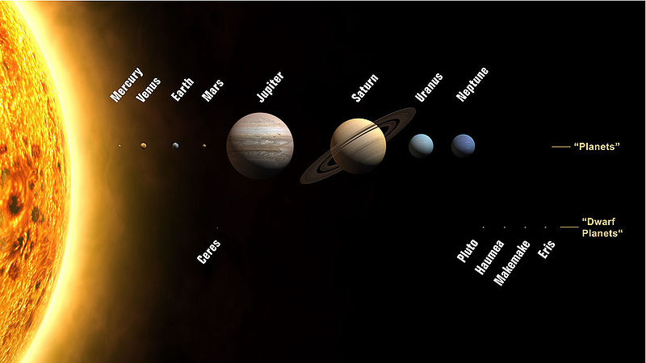
State of the Solar System 2011
With Paul Richards, Hank Lederer, Michael Kauper & Ben Huset
DIVERSICON 19
“Dark Descents, Ascending Wonders”
July 29-31, 2011
Best Western—Bandana Square 1010 W Bandana Blvd St Paul, MN 55108-5107

Slide 2
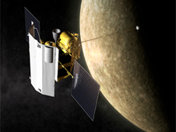
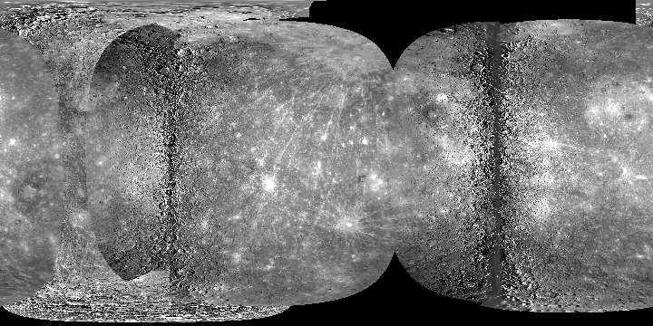
Messenger
The first spacecraft designed by NASA to orbit Mercury is giving scientists a new perspective on the planet's atmosphere and evolution.
Launched Aug 3, 2004
Third and final flyby on 29 September 2009
Orbit Insertion, March 18, 2011 http://messenger.jhuapl.edu/

Slide 3
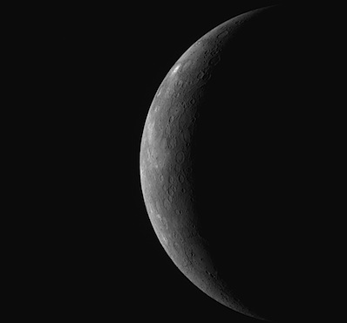
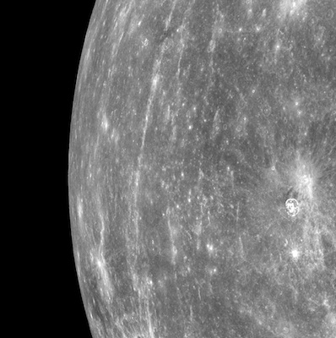

Slide 4
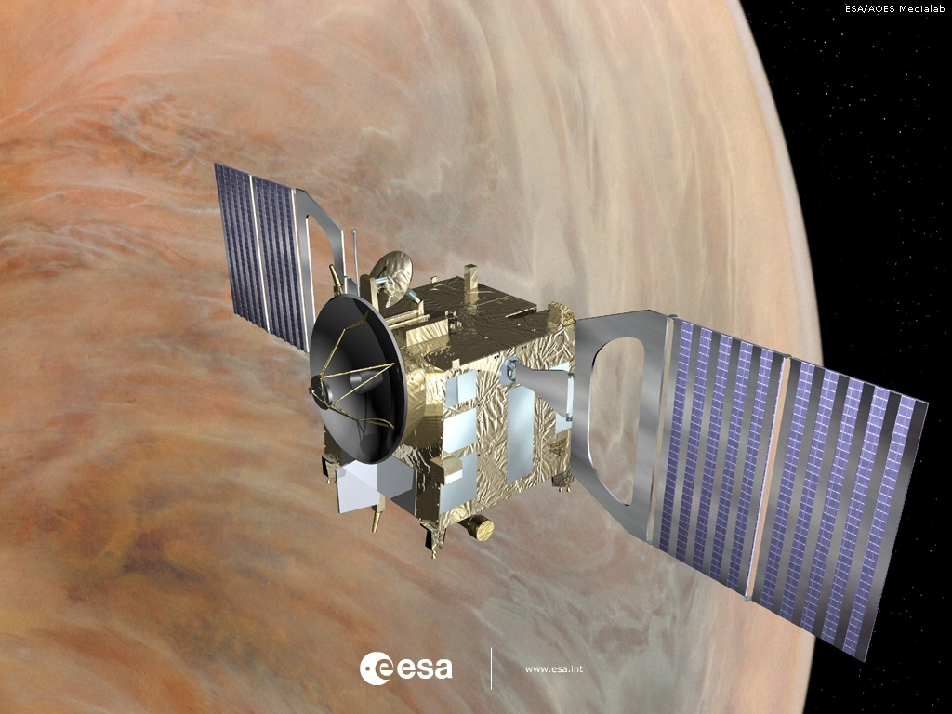
Venus Express
http://www.esa.int/esaMI/Venus_Express/index.html

Slide 5
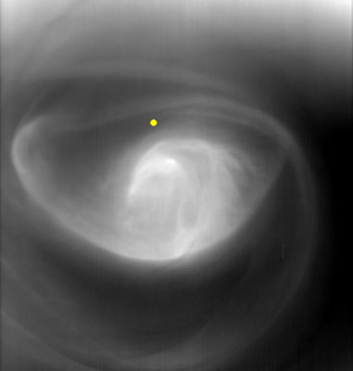
South Pole Vortex

Slide 6
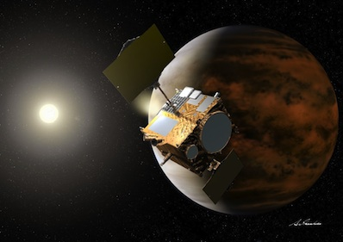
Akatsuki @ Venus
Missed it by That Much.
Try Again in 6 years.
Dec 6, 2010

Slide 7
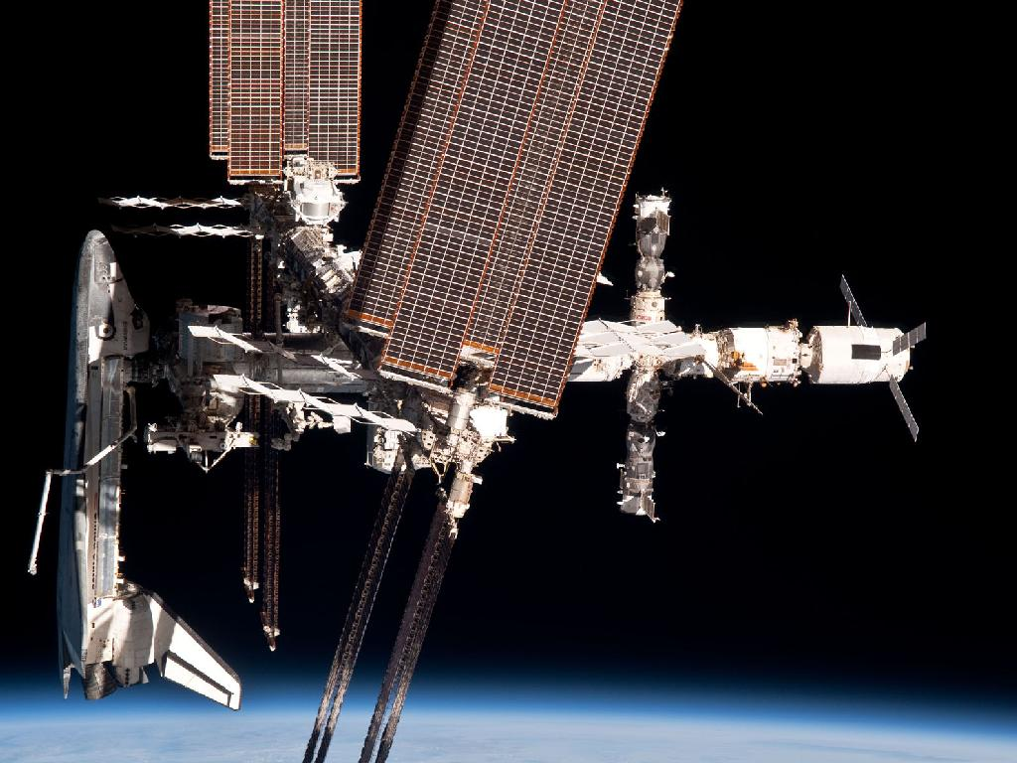
STS / ISS

Slide 8
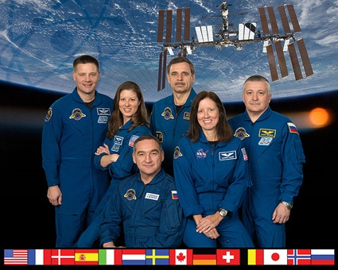
June 1, 2010 –Sept 25, 2010: ISS-24

Slide 9
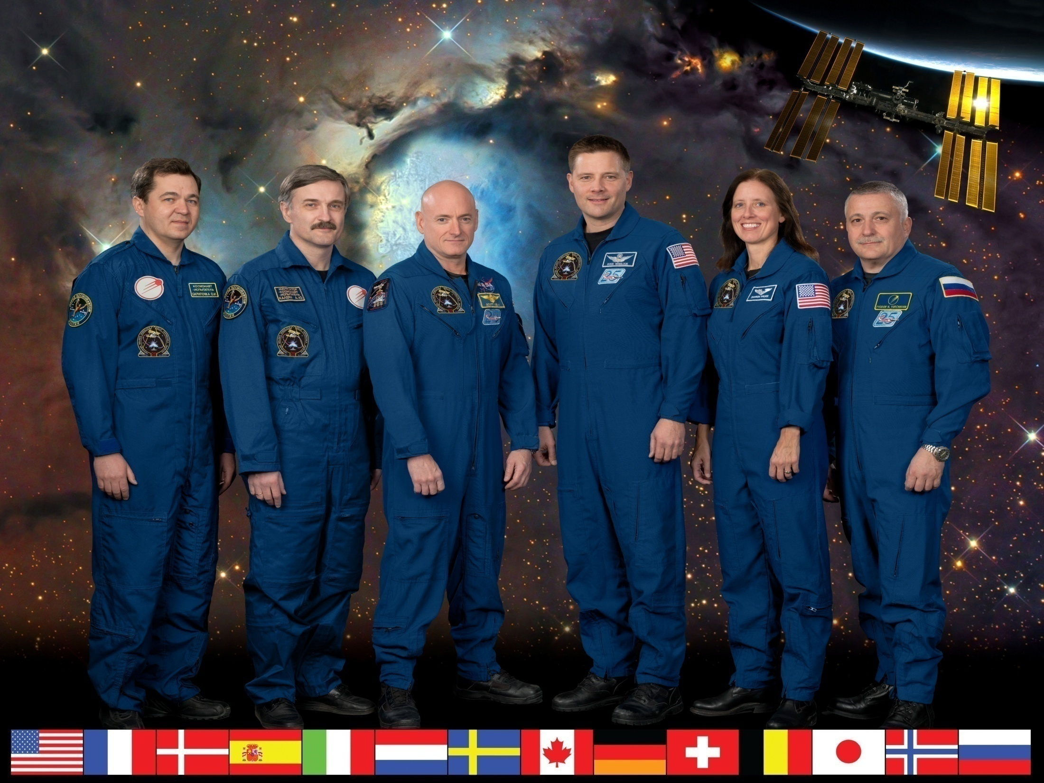
Sept 25, 2010- Nov 26, 2010 : ISS-25

Slide 10
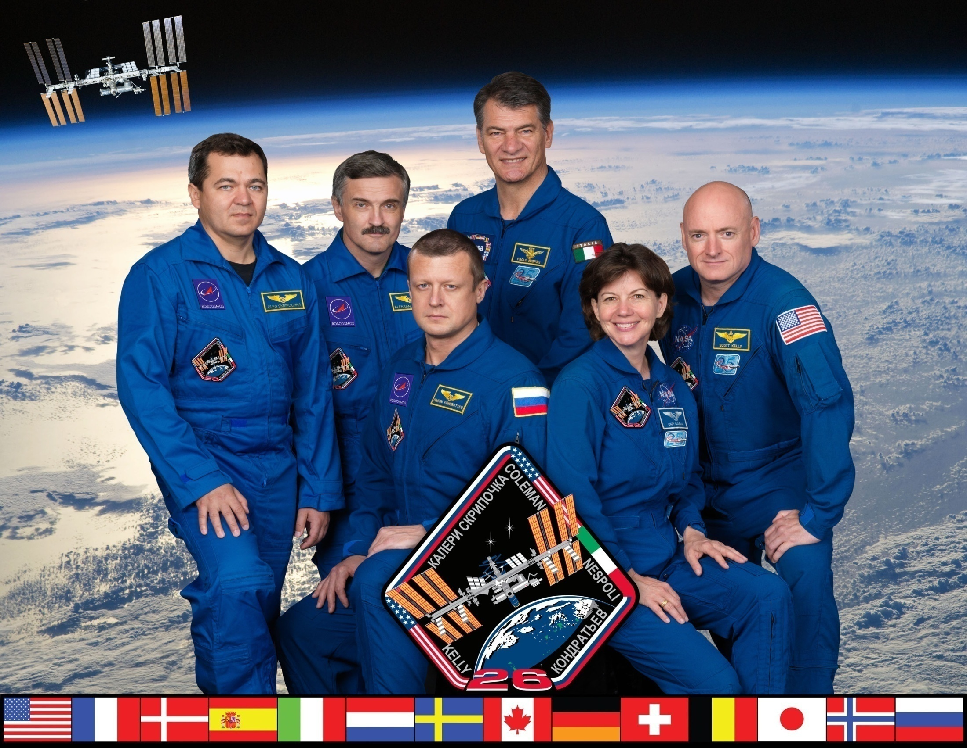
Nov 26, 2010 –Mar 16, 2011: ISS-26

Slide 11
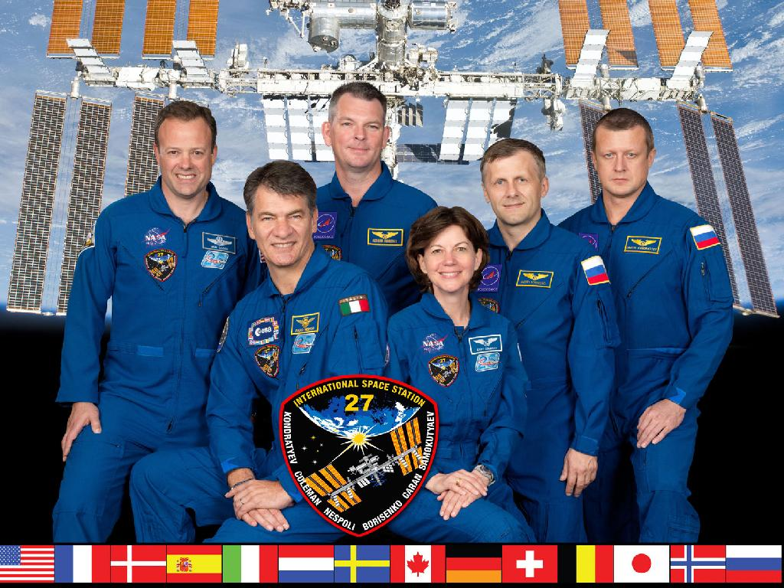
March 16– May 23, 2011: ISS-27

Slide 12
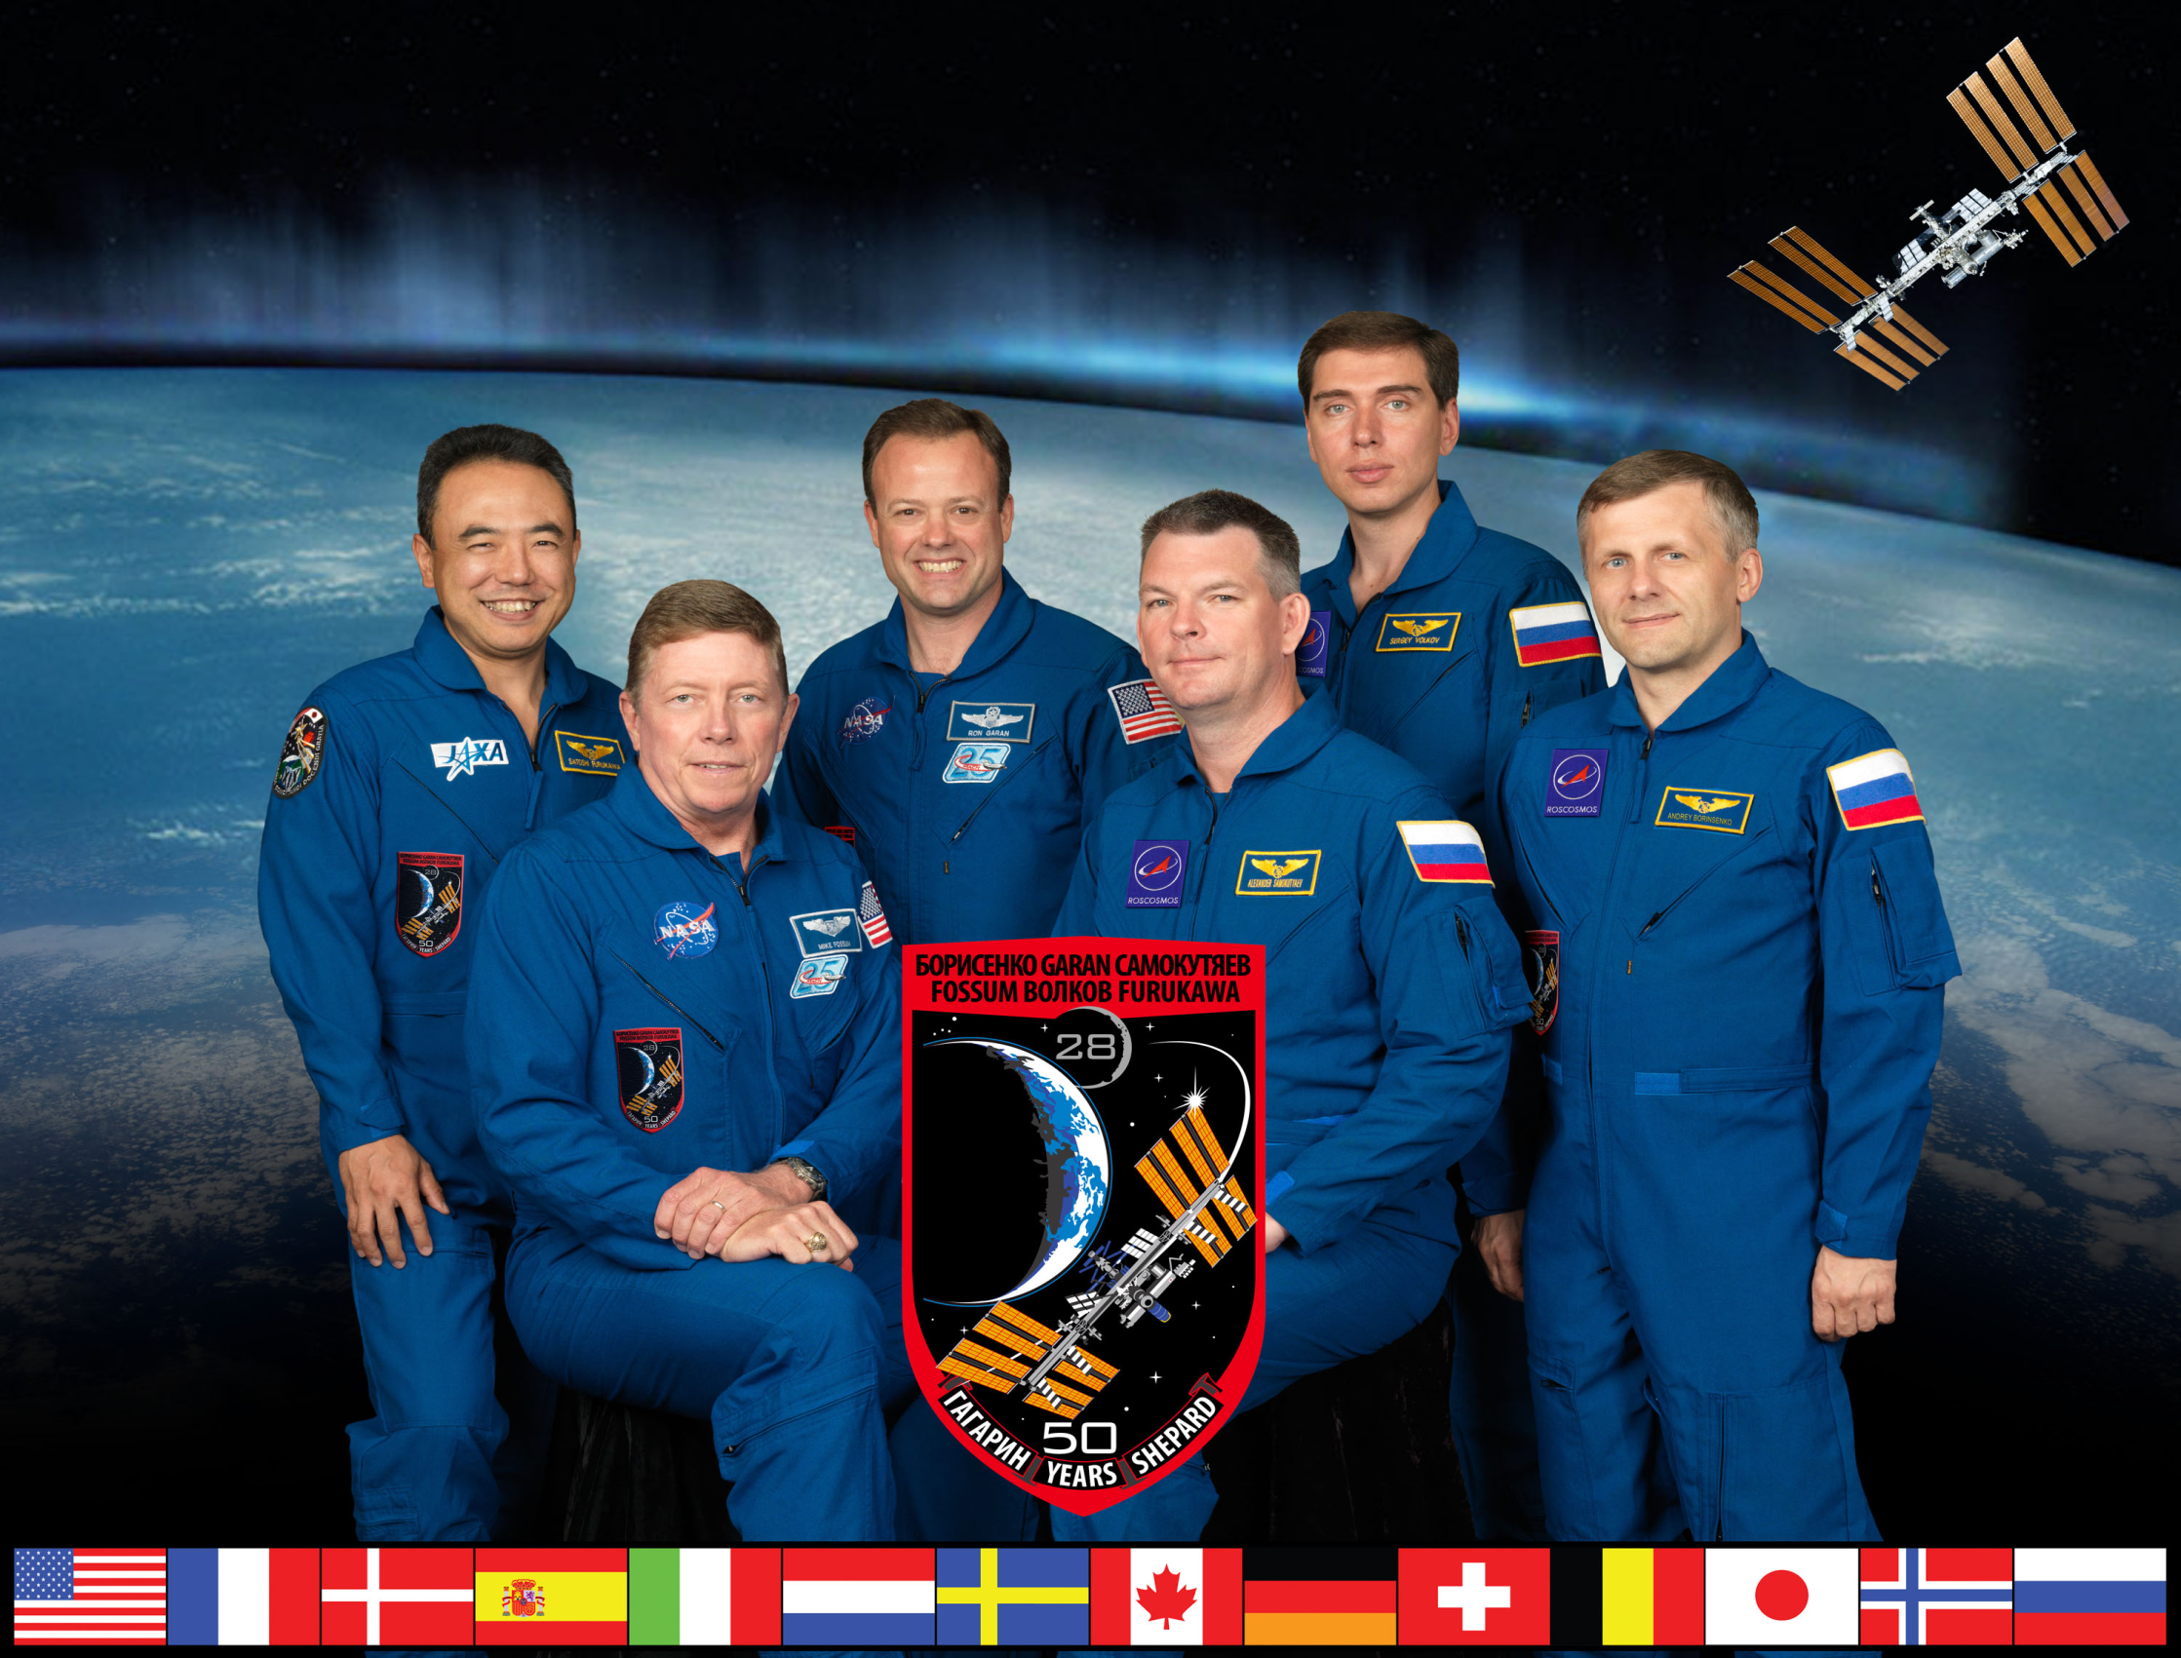
May 23 – Sept ??, 2011: ISS-28

Slide 13
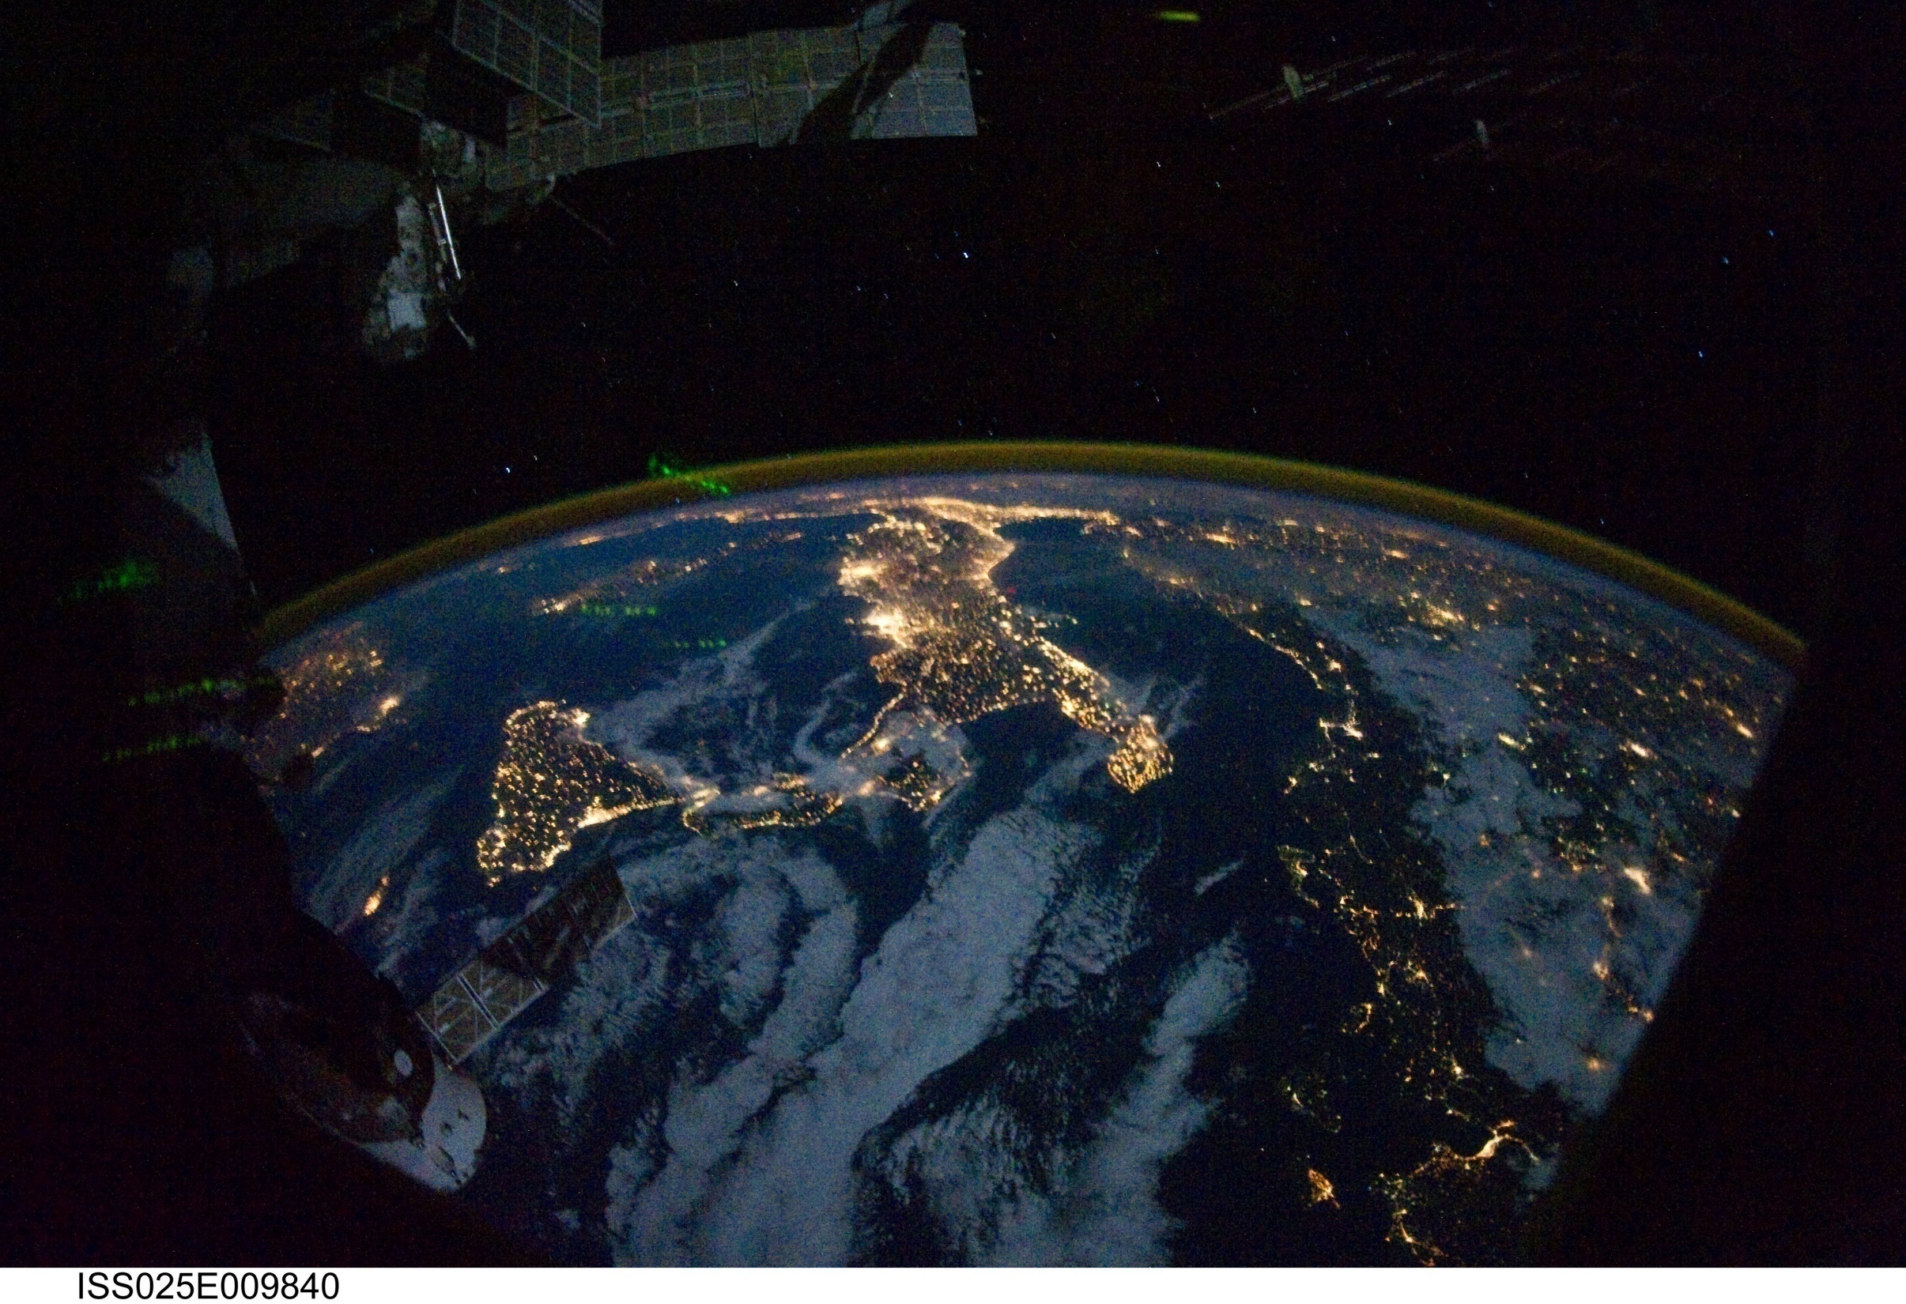
Italy at Night

Slide 14
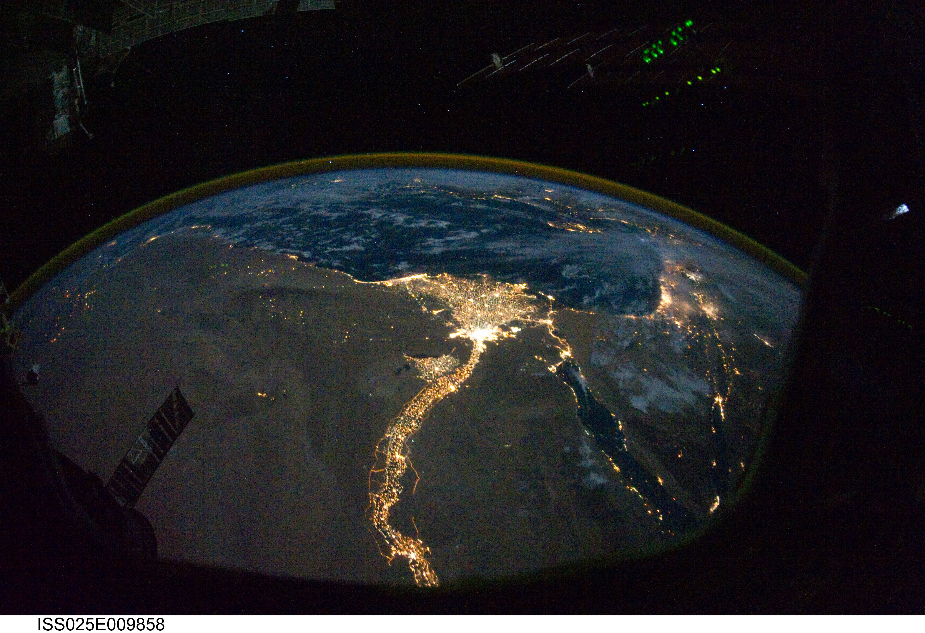
Egypt at Night

Slide 15
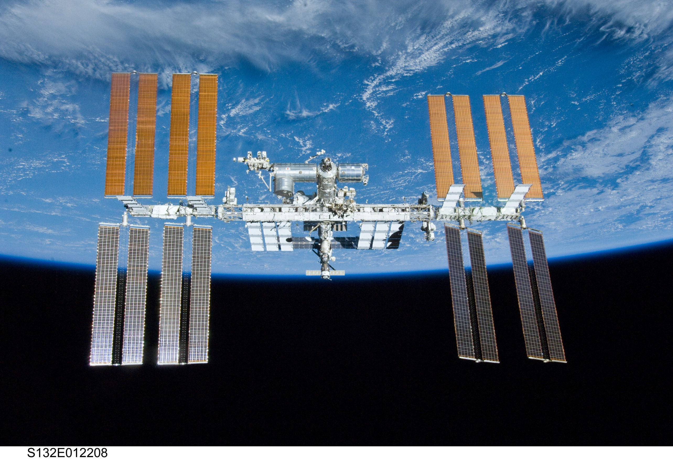
2028? (30 yrs)
2020
Open till 2015

Slide 16
NASA funding for space station research is driven by the goals of the NASA Authorization Act of 2010. These goals focus on:
human health and countermeasure development to protect crewmembers from the space environment during long-duration voyages
testing research and technology developments for future exploration missions
developing and validating operational procedures for long-duration space missions
maintaining US capability in the areas of physical and life sciences through the use of microgravity

Slide 17
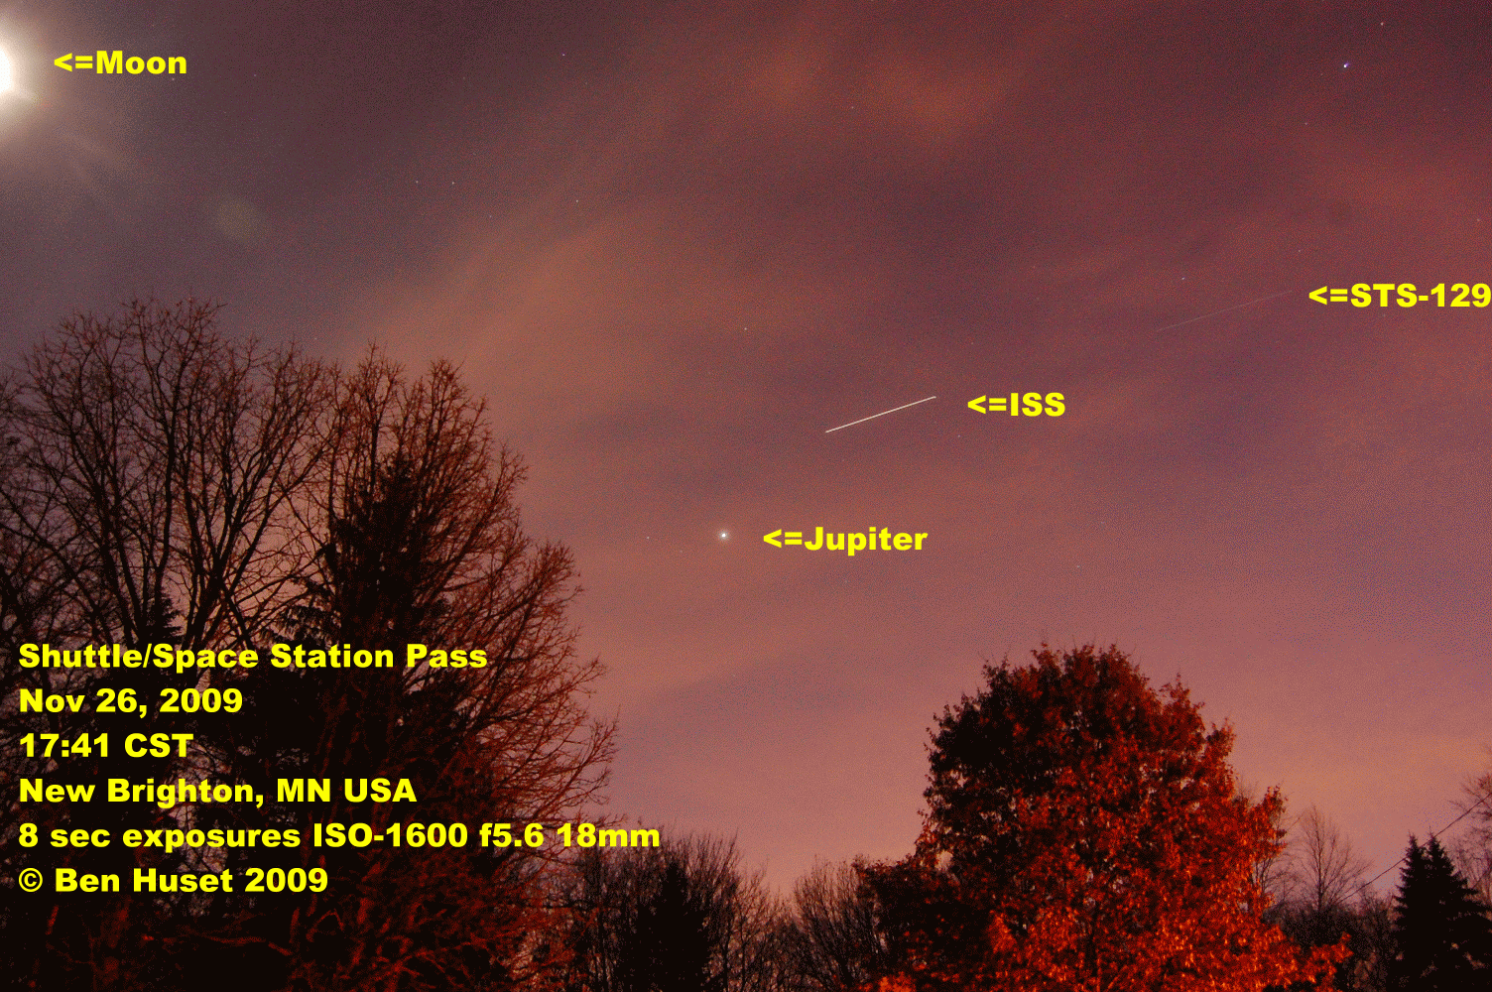

Slide 18
ISS - Visible Passes http://heavens-above.com
Date | Mag | Starts |  |  | Max. altitude |  |  | Ends
 |  | Time | Alt. | Az. | Time | Alt. | Az. | Time | Alt. | Az.
29 Jul | -1.4 | 03:33:30 | 19 | ESE | 03:33:30 | 19 | ESE | 03:35:24 | 10 | E
29 Jul | -3.1 | 05:05:47 | 10 | WSW | 05:08:52 | 61 | NNW | 05:11:59 | 10 | NE
30 Jul | -3.5 | 04:10:05 | 41 | SW | 04:10:58 | 71 | SSE | 04:14:06 | 10 | ENE
31 Jul | -1.6 | 03:14:20 | 25 | E | 03:14:20 | 25 | E | 03:16:04 | 10 | ENE
31 Jul | -2.4 | 04:46:37 | 12 | W | 04:49:14 | 41 | NNW | 04:52:15 | 10 | NE
1 Aug | -3.3 | 03:50:50 | 58 | W | 03:51:15 | 69 | NNW | 03:54:23 | 10 | ENE
1 Aug | -1.5 | 05:25:03 | 10 | WNW | 05:27:44 | 25 | N | 05:30:25 | 10 | NE
2 Aug | -1.4 | 02:55:01 | 24 | ENE | 02:55:01 | 24 | ENE | 02:56:28 | 10 | ENE
2 Aug | -1.9 | 04:27:18 | 13 | WNW | 04:29:37 | 31 | NNW | 04:32:28 | 10 | NE
3 Aug | -2.6 | 03:31:27 | 44 | NNW | 03:31:34 | 44 | NNW | 03:34:35 | 10 | NE
3 Aug | -1.3 | 05:05:33 | 10 | WNW | 05:08:10 | 23 | N | 05:10:46 | 10 | NE
4 Aug | -0.9 | 02:35:36 | 20 | ENE | 02:35:36 | 20 | ENE | 02:36:42 | 10 | ENE
4 Aug | -1.4 | 04:07:53 | 14 | WNW | 04:10:00 | 26 | N | 04:12:42 | 10 | NE
5 Aug | -1.8 | 03:12:02 | 32 | N | 03:12:02 | 32 | N | 03:14:45 | 10 | NE
5 Aug | -1.2 | 04:45:55 | 10 | NW | 04:48:33 | 24 | N | 04:51:10 | 10 | ENE
6 Aug | -0.5 | 02:16:11 | 15 | NE | 02:16:11 | 15 | NE | 02:16:50 | 10 | NE
6 Aug | -1.2 | 03:48:28 | 14 | NW | 03:50:21 | 24 | N | 03:52:58 | 10 | NE
6 Aug | -1.7 | 05:24:08 | 10 | NW | 05:27:02 | 33 | NNE | 05:29:55 | 10 | E
7 Aug | -1.2 | 02:52:39 | 25 | N | 02:52:39 | 25 | N | 02:54:54 | 10 | NE
7 Aug | -1.3 | 04:26:10 | 10 | NW | 04:28:53 | 26 | N | 04:31:35 | 10 | ENE

Slide 19
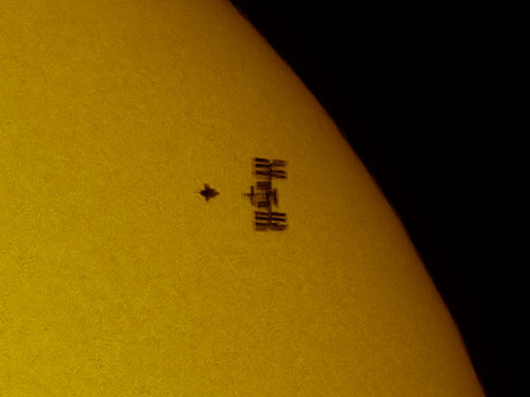
STS / ISS SolarTransit

Slide 20
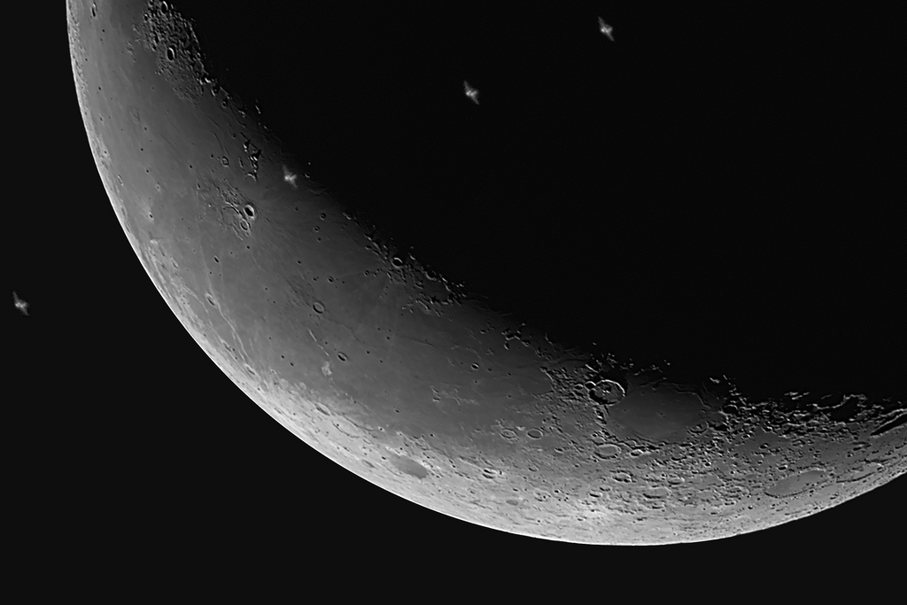
ISS Lunar Transit

Slide 21
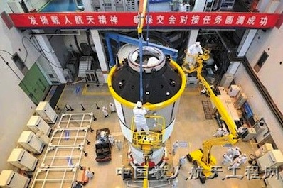
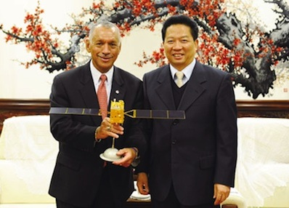
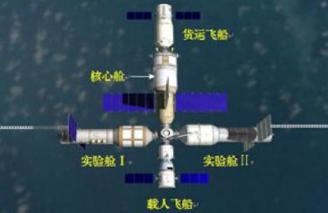
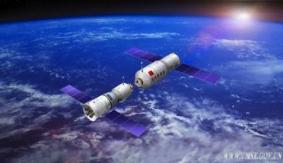
China’s Space Station
Tiangong 1 (heavenly palace)
Shenzhou 8

Slide 22
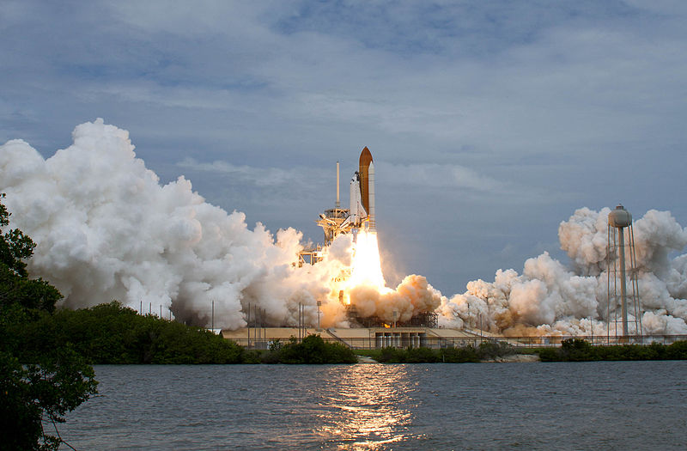
Space Shuttle 1981 - 2011

Slide 23
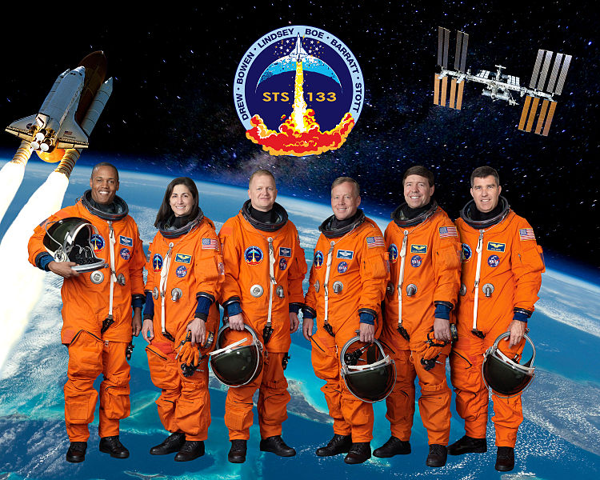
Feb 24 – Mar 9 2011: STS-133

Slide 24
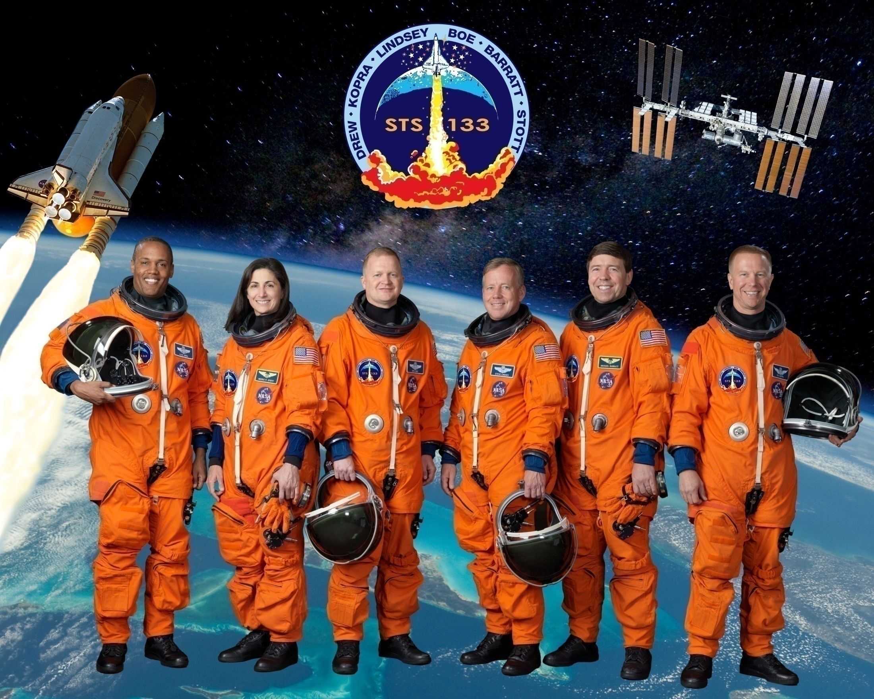
Nov 2010? : STS-133

Slide 25
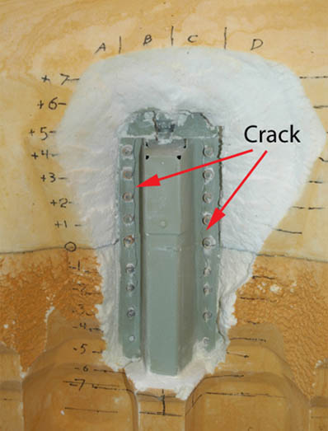
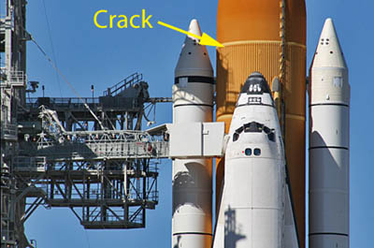
Tank Cracks

Slide 26
STS-133 Payloads
1.1 Permanent Multipurpose Module
1.2 ExPRESS Logistics Carrier 4
1.3 Robonaut2
1.4 SpaceX DragonEye sensor

Slide 27
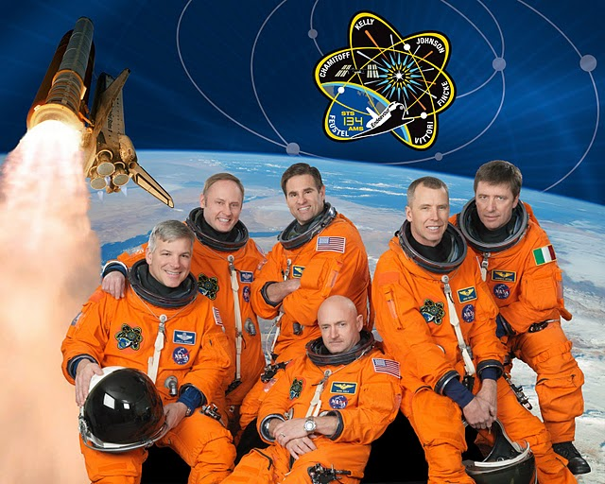
May 16 – June 1 2011: STS-134

Slide 28
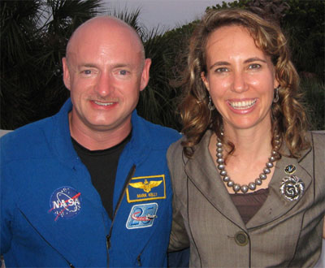
Mark Kelly (Astronaut)
Gabrielle Giffords U.S. Congresswoman (D) AZ-28th

Slide 29
Mission Payloads
4 Mission payload 4.1 Alpha Magnetic Spectrometer 2
4.2 ExPRESS Logistics Carrier 3
4.3 Materials on International Space Station Experiment
4.4 Sensor Test of Orion Rel-nav Risk Mitigation Detailed Test Objective kit
4.5 GLACIER Freezer Module
4.6 Orbiter Boom Sensor System
4.7 Lego kits

Slide 30
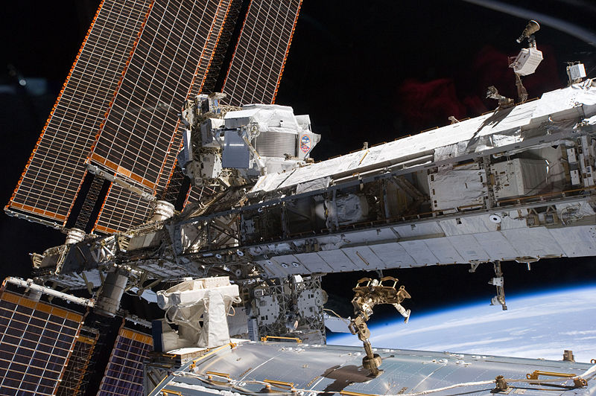
Starboard truss of the ISS with the newly-installed AMS-02

Slide 31
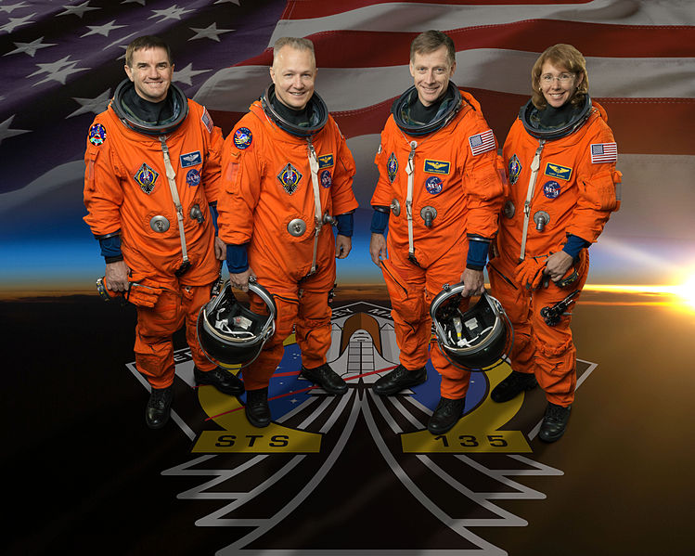
July 8– July 21, 2011: STS-135

Slide 32
STS-135 Payloads
5.1 Multi-Purpose Logistics Module
5.2 Lightweight Multi-Purpose Carrier
5.3 Robotic Refueling Mission
5.4 Picosatellite Solar Cell Testbed 2
5.5 TriDAR
5.6 Down-mass payload
5.7 Other supplies

Slide 33
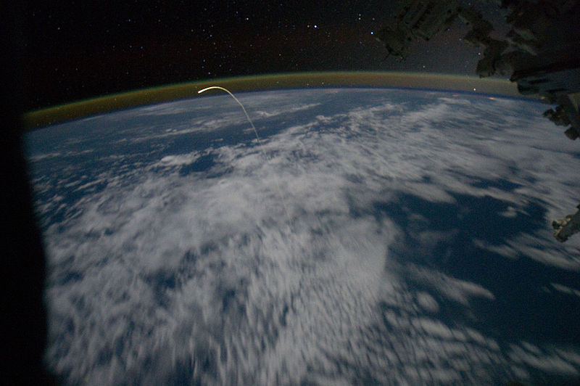

Slide 34
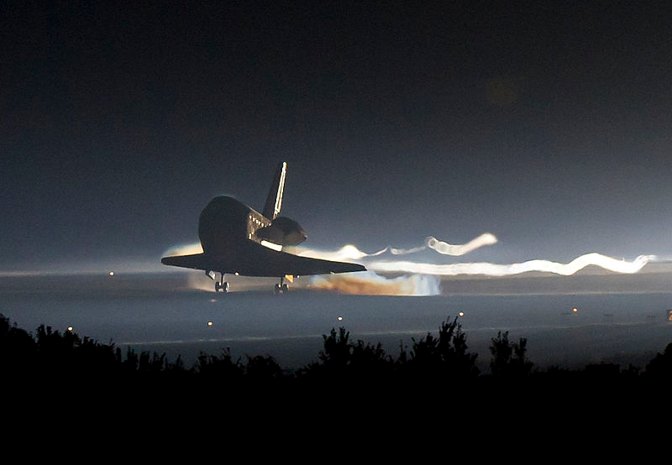
166th (and the final currently planned) NASA manned space flight
135th shuttle mission since STS-1
33rd flight of Atlantis
3rd shuttle flight in 2011
37th shuttle mission to the ISS
110th post-Challenger mission
22nd post-Columbia mission
100th day launch
133rd landing overall, 78th at KSC, 26th night landing, 20th night landing at KSC

Slide 35
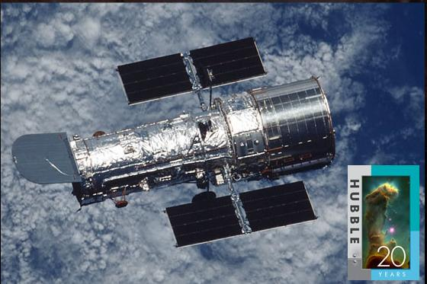
April 24, 1990-???
http://hubblesite.org
1
NASA's Hubble Makes One Millionth Science Observation

Slide 40
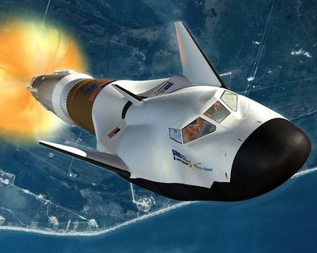
Dream Chaser
http://www.sncorp.com

Slide 41
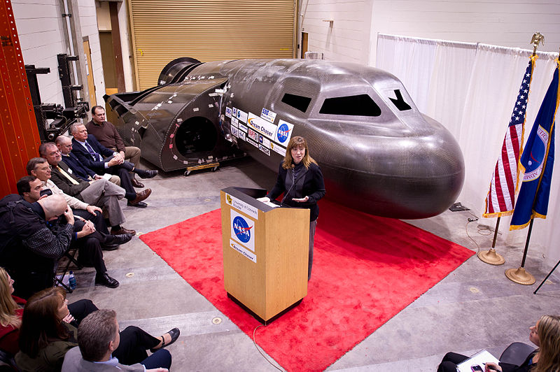
Feb 2011 Sierra Nevada (Space Dev)

Slide 42
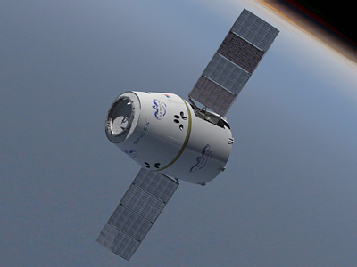
Dragon
http://www.spacex.com/

Slide 43
Dragon
Fully autonomous rendezvous and docking with manual override capability in crewed configuration
6,000 kg (13,228 lbs) payload up-mass to LEO; 3,000 kg (6,614 lbs) payload down-mass
Payload Volume: 10 m3 (350 ft3) pressurized, 14 m3 (490 ft3) unpressurized
Supports up to 7 passengers in Crew configuration
Two-fault tolerant avionics system with extensive heritage
Reaction control system with 18 MMH/NTO thrusters designed and built in-house; these thrusters are used for both attitude control and orbital maneuvering
1290 kg of propellant supports a safe mission profile from sub-orbital insertion to ISS rendezvous to reentry
Integral common berthing mechanism, with LIDS or APAS support if required
Designed for water landing under parachute for ocean recovery
Lifting re-entry for landing precision & low-g’s
Ablative, high-performance heat shield and sidewall thermal protection

Slide 44
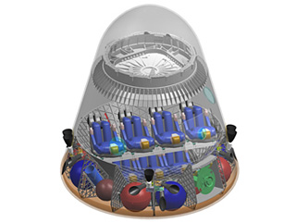
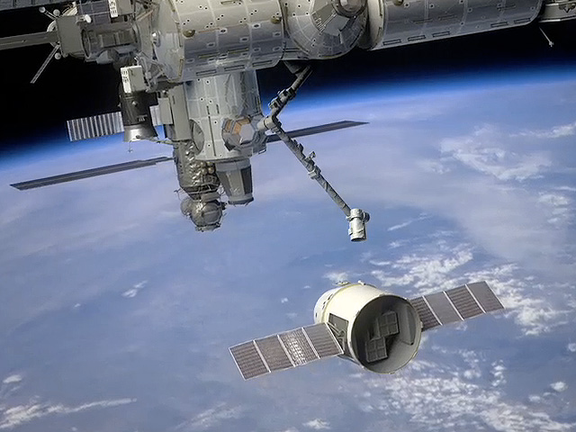
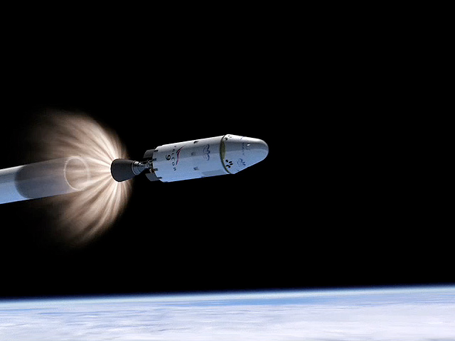
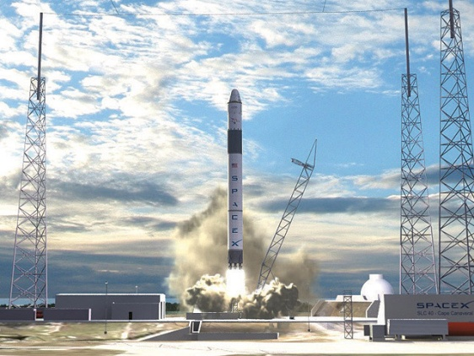
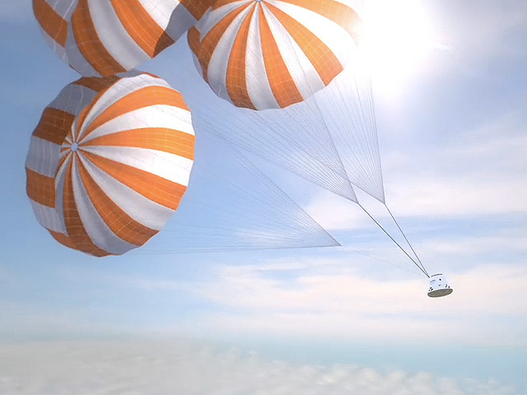
Cargo
Dragon
Crewed

Slide 45
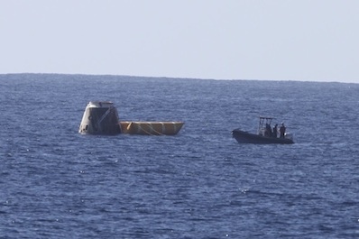
Dec 8, 2010
1st Dragon Flight
2nd Falcon 9 Flight
Next flight Nov. 2011 ??
For more information on SpaceX:
Visit Us: www.spacex.com
Like Us: www.facebook.com/SpaceX
Follow Us: www.twitter.com/SpaceXer
Watch Us: www.youtube.com/SpaceXChannel

Slide 46
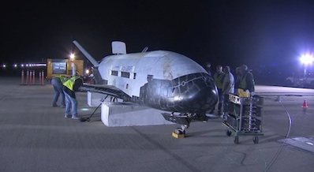
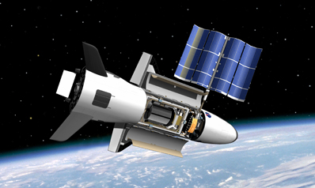
X-37B
General characteristics
Crew: None
Length: 29 ft 3 in (8.9 m)
Wingspan: 14 ft 11 in (4.5 m)
Height: 9 ft 6 in (2.9 m)
Loaded weight: 11,000 lb (4,990 kg)
Power: Gallium arsenide solar cells with lithium-ion batteries
Payload Bay: 7 × 4 ft (2.1 × 1.2 m)
Performance
Orbital speed: 17,500 mph (28,200 km/h)
Orbit: Low Earth orbit
Orbital time: Up to 270 days
USA 212 Apr 2010-Dec 2010
USA 226 Mar 2011-??
http://www.af.mil/information/factsheets/factsheet.asp?fsID=16639

Slide 47
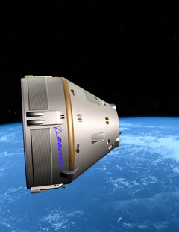
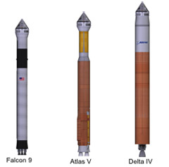
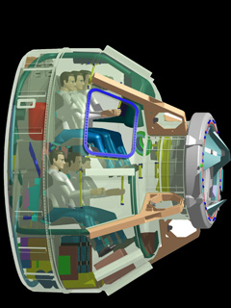
CST-100
Crew Space Transportation the number 100 in the name stands for 100 km

Slide 48
Multi-Purpose Crew Vehicle
(Formerly known as Orion)

Slide 49
Russian Soyuz in French Guiana (South America)
Launching this fall ???

Slide 50
India’s Geosynchronous Satellite Launch Vehicle
http://spaceflightnow.com/news/n1012/31gslv/

Slide 51
Heavy-lift Space Launch System
Stay tuned for details

Slide 52
Genesis I & II
(In Space NOW)
Space Hotel

Slide 53
James Web Space Telescope
http://www.jwst.nasa.gov/

Slide 54
6.5 m
2.4 m

Slide 56
0.6 to 28.5 microns

Slide 58
Mirrors are Done.

Slide 59
James Web Space Telescope
2011 Launch ? $1.6 billion
2014 Launch ?
2015 Launch?
2018 launch?? $6.8 billion
2020 Launch $,$$$,$$$,$$$?
Cancel???
http://www.jwst.nasa.gov/

Slide 60
Mars 2001 Odyssey
NASA's Mars Odyssey, which launched in 2001, broke the record Wednesday Dec 15 2010, for longest-serving spacecraft at the Red Planet. The probe begins its 3,340th day in Martian orbit at 5:55 p.m. PST (8:55 p.m. EST) on Wednesday to break the record set by NASA's Mars Global Surveyor, which orbited Mars from 1997 to 2006.
Odyssey's longevity enables continued science, including the monitoring of seasonal changes on Mars from year to year and the most detailed maps ever made of most of the planet.
http://marsprogram.jpl.nasa.gov/odyssey/

Slide 61
Mars Exploration Rovers
http://marsrovers.jpl.nasa.gov/

Slide 63
Spirit : A Job Well Exceeded
Designed as a 3-month mission with a kilometer of traverse capability. The rover lasted over 6 years and drove over 7.7 kilometers [4.8 miles] and returned over 124,000 images.

Slide 65
2004 2008 2011
Opportunity Tops 20 Miles of Mars Driving
July 19, 2011 2,658th Martian Sol

Slide 66
Santa Maria Crater
Jan-March 2011 90-meter-diameter (295-foot-diemeter)

Slide 67
View from Opportunity
July 2011

Slide 68
Mars Express:
http://mars.esa.int/ http://marsprogram.jpl.nasa.gov/express/

Slide 69
NASA Orbiter Reveals Big Changes in Mars' Atmosphere
MRO discovered the total amount of atmosphere on Mars changes dramatically as the tilt of the planet's axis varies. This process can affect the stability of liquid water, if it exists on the Martian surface, and increase the frequency and severity of Martian dust storms.
The newly found deposit has a volume similar to Lake Superior's nearly 3,000 cubic miles (about 12,000 cubic kilometers). The deposit holds up to 80 percent as much carbon dioxide as today's Martian atmosphere. Collapse pits caused by dry ice sublimation and other clues suggest the deposit is in a dissipating phase, adding gas to the atmosphere each year.
http://mars.jpl.nasa.gov/mro/
Mars Reconnaissance Orbiter
Cross Section of Buried Carbon-Dioxide Ice on Mars

Slide 70
Mars Science Lab Curiosity
Launch Window: Nov. 25 to Dec. 18, 2011 T-117 Days 21hrs

Slide 71
Winner

Slide 72
4.6°S 137.2°E.
Spirit ->

Slide 73
Gale Crater

Slide 74
Arrives August 2012

Slide 75
Dawn / Vesta - Ceres
http://dawn.jpl.nasa.gov.

Slide 76
July, 2012
Sept, 2007
July, 2011
July, 2015?
Feb 2015

Slide 78
~320 mi diameter Brightest
2nd most Massive
3rd Largest

Slide 79
HST Views

Slide 80
Finding Vesta -> Tonight
Mag 5.7

Slide 81
Juno @ Jupiter
Launching Aug 5, 2011 ??
Arrival : July 2016
http://www.nasa.gov/mission_pages/juno/main/index.html

Slide 82
Determine how much water is in Jupiter’s atmosphere, which helps determine which planet formation theory is correct (or if new theories are needed)
Look deep into Jupiter’s atmosphere to measure composition, temperature, cloud motions and other properties
Map Jupiter’s magnetic and gravity fields, revealing the planet’s deep structure
Explore and study Jupiter’s magnetosphere near the planet’s poles, especially the auroras – Jupiter’s northern and southern lights – providing new insights about how the planet’s enormous magnetic force field affects its atmosphere.

Slide 84
ExoPlanet Hunting
Beyond our Solar System
Total exoplanets * 564
Stars with planets 474
Gas Giants 343
Hot Jupiters 141
Earthlike Planets 0
Other Planets 80
* Pulsar planets are not included in this tally.
http://planetquest1.jpl.nasa.gov/atlas/atlas_index.cfm

Slide 85
Kepler
Launched March 7, 2009 Looking at 145,000 stars
Planets found : 17
1235 planet “candidates”
http://kepler.nasa.gov/
Follow the mission on Twitter at www.twitter.com/NASAKepler Facebook at www.facebook.com/nasaskeplermission.

Slide 88
1,235 Planet Candidates and Their Stars

Slide 89
http://setistars.org/
SETI Needs Your Help to Resume Search for Extraterrestrial Life
1798 stars (donors)
$184,554 out of $200,000

Slide 91
Hayabusa

Slide 92
Hayabusa
25143 Itokawa
Launch date : May 9th, 2003 Landed : June 14th, 2010

Slide 93
Cassini Spacecraft Captures Images and Sounds of Big Saturn Storm
Scientists analyzing data from NASA's Cassini spacecraft now have the first-ever, up-close details of a Saturn storm that is eight times the surface area of Earth.. It appears approximately 35 degrees north latitude of Saturn. Pictures from Cassini's imaging cameras show the storm wrapping around the entire planet covering approximately 2 billion square miles .
July 2011 http://saturn.jpl.nasa.gov

Slide 94
Cassini: Saturn’s invisible radiation belts are like much of the rest of the planet’s system – unique

Slide 95
Electrical Circuit Between Saturn and Enceladus
April 2011

Slide 96
HST finds Pluto has a 4th Moon

Slide 97
Surf &Twitter

Slide 98
To be Continued…

Slide 99
Questions ?

Slide 100
Advanced Composition Explorer (ACE) ACE orbits the L1 libration point which is a point of Earth-Sun gravitational equilibrium about 1.5 million km from Earth From its location at L1 ACE has a prime view of the solar wind, interplanetary magnetic field and higher energy particles accelerated by the Sun, as well as particles accelerated in the heliosphere and the galactic regions beyond. http://www.srl.caltech.edu/ACE/
AIM: Aeronomy of Ice in the Mesosphere AIM's two-year mission is to study Polar Mesospheric Clouds, the Earth’s highest clouds, which form an icy membrane 50 miles above the surface at the edge of space.
http://www.nasa.gov/mission_pages/aim/index.html
Aqua Aqua, Latin for water, is a NASA Earth Science satellite mission named for the large amount of information that the mission will be collecting about the Earth's water cycle.
http://www.nasa.gov/mission_pages/aqua/index.html

Slide 101
ARCTAS
Arctic Research of the Composition of the Troposphere from Aircraft and Satellites http://www.nasa.gov/mission_pages/arctas/
Astro-E2/Suzaku
The Suzaku mission is a joint effort of JAXA and NASA designed to discover more about the x-ray universe. http://www.nasa.gov/mission_pages/astro-e2/main/index.html
Aura Mission
A mission dedicated to the health of Earth's atmosphere. http://www.nasa.gov/mission_pages/aura/main/index.html
CALIPSO
CALIPSO will provide the next generation of climate observations, drastically improving our ability to predict climate change and to study the air we breathe. http://www.nasa.gov/mission_pages/calipso/main/index.html

Slide 102
Cassini-Huygens Mission
Unlocking the secrets of Saturn. http://www.nasa.gov/mission_pages/cassini/main/index.html
Chandra X-ray Observatory
NASA's Chandra X-Ray Observatory probes the mysteries of space with unprecedented x-ray images that help to unravel the structure and evolution of the universe.
http://www.nasa.gov/mission_pages/chandra/main/index.html
CINDI
CINDI will study the elements that influence space weather near Earth's equator. http://www.nasa.gov/mission_pages/cindi/
CloudSat
CloudSat's cloud-profiling radar is 1,000 times more sensitive than typical weather radar and can detect clouds and distinguish between cloud particles and precipitation. http://www.nasa.gov/mission_pages/cloudsat/main/index.html

Slide 103
Cosmic Hot Interstellar Plasma Spectrometer (CHIPS)
CHIPS uses an extreme ultraviolet spectrograph to study the "Local Bubble" surrounding our Solar System. http://chips.ssl.berkeley.edu/chips.html
Constellation
Ares rockets and the Orion crew vehicle.
http://www.nasa.gov/mission_pages/constellation/main/index.html
Cluster ESA/NASA Mission
The four Cluster spacecraft carry out 3D measurements in the Earth's Magnetosphere. http://sci.esa.int/science-e/www/area/index.cfm?fareaid=8
Dawn
Dawn becoming the first spacecraft ever planned to orbit two different bodies after leaving Earth. The spacecraft will orbit Vesta and Ceres, two of the largest asteroids in the solar system. http://www.nasa.gov/mission_pages/dawn/main/index.html

Slide 104
Earth Probe Total Ozone Mapping Spectrometer (EP-TOMS) →
Earth Probe Total Ozone Mapping Spectrometer (EP-TOMS), along with the Ozone Monitoring Instrument onboard AURA, are currently the only NASA spacecraft on orbit specializing in ozone retrieval. http://toms.gsfc.nasa.gov/eptoms/ep.html
Earth Observing-1
As the first New Millennium Program Earth Observing Mission, EO-1 has validated advanced land imaging and unique spacecraft technologies. http://eo1.gsfc.nasa.gov/
EPOXI
EPOXI is a low-cost mission that will expand our knowledge of both cometary bodies and extrasolar planetary systems. http://www.nasa.gov/mission_pages/epoxi/index.html
Fire and Smoke
NASA satellites, aircraft, and research know-how have created a wealth of cutting-edge tools to help firefighters battle wildfires. http://www.nasa.gov/mission_pages/fires/main/index.html

Slide 105
GALEX
Mapping the history of star formation in the universe.
Galaxy Evolution Explorer http://www.nasa.gov/mission_pages/galex/index.html
GLAST Launches on Gamma Ray Mission Fermi
The Gamma-ray Large Area Space Telescope will answer questions about supermassive black hole systems, pulsars and the origin of cosmic rays. http://www.nasa.gov/mission_pages/GLAST/main/index.html
Geostationary Operational Environmental Satellites (GOES)
GOES-N is the latest in a series of satellites that provide a constant vigil for the atmospheric "triggers" for severe weather conditions such as tornadoes and hurricanes.
http://www.nasa.gov/mission_pages/goes-n/main/index.html
GOES-O
The Geostationary Operational Environmental Satellite (GOES)-O represents the newest generation of environmental satellites. http://www.nasa.gov/mission_pages/GOES-O/main/index.html

Slide 106
GOES-P
The Geostationary Operational Environmental Satellite (GOES)-P represents the newest generation of environmental satellites. http://www.nasa.gov/mission_pages/GOES-P/main/index.html
Geotail Mission
A mission to study the tail of Earth's magnetosphere. http://pwg.gsfc.nasa.gov/geotail.shtml
Gravity Probe B
This mission is the relativity gyroscope experiment developed by NASA and Stanford University to test two unverified predictions of Albert Einstein's general theory of relativity. http://www.nasa.gov/mission_pages/gpb/index.html
Gravity Recovery and Climate Experiment GRACE
The twin satellites are making detailed measurements of Earth's gravity field to learn more about gravity and Earth's natural systems.

Slide 107
Genesis and Rapid Intensification Processes (GRIP) experiment is a NASA Earth science field experiment in 2010 that will be conducted to better understand how tropical storms form and develop into major hurricanes. http://www.nasa.gov/mission_pages/hurricanes/missions/grip/main
Hayabusa (MUSES-C)
Hayabusa (MUSES-C) is Japan's asteroid sample return mission.
http://www.isas.jaxa.jp/e/enterp/missions/hayabusa/index.shtml
Herschel
The Herschel Space Observatory is a space-based telescope that will study the Universe by the light of the far-infrared and submillimeter portions of the spectrum. Herschel is a European Space Agency mission with significant participation from NASA. http://www.nasa.gov/mission_pages/herschel/index.html http://www.herschel.caltech.edu/ http://sci.esa.int/science-e/www/area/index.cfm?fareaid=16

Slide 108
High Energy Transient Explorer-2 (HETE-2) Mission
HETE-2 is a small scientific satellite designed to detect and localize gamma-ray bursts. http://space.mit.edu/HETE/
Hinode (Solar B)
A collaboration between the space agencies of Japan, the United States, United Kingdom and Europe, Hinode's mission is to investigate the interaction between the sun's magnetic field and its corona. http://www.nasa.gov/mission_pages/hinode/index.html
Hubble Space Telescope
Learn how Hubble has expanded our knowledge of the cosmos. http://www.nasa.gov/mission_pages/hubble/main/index.html

Slide 109
IBEX
A mission to achieve the first global observations of the region beyond the termination shock at the very edge of our solar system. http://www.nasa.gov/mission_pages/ibex/index.html
Ice Cloud and Land Elevation Satellite (ICEsat) Mission
The ICESat mission will provide multi-year elevation data regarding ice sheet mass balance as well as cloud property information, especially for stratospheric clouds common over polar areas. http://icesat.gsfc.nasa.gov/
International Gamma-Ray Astrophysics Laboratory (INTEGRAL)
INTEGRAL is the most sensitive gamma-ray observatory ever launched. http://sci.esa.int/science-e/www/area/index.cfm?fareaid=21

Slide 110
International Space Station
Aboard the International Space Station, astronauts work to improve life on Earth and extend life beyond our home planet. http://www.nasa.gov/mission_pages/station/main/index.html
Jason
Jason-1 is the first follow-on to the highly successful TOPEX/Poseidon mission that measured ocean surface topography. http://sealevel.jpl.nasa.gov/mission/jason-1.html
Kepler
NASA's search for habitable planets.
http://www.nasa.gov/mission_pages/kepler/main/index.html
Landsat
The Landsat Program is a series of Earth-observing satellite missions jointly managed by NASA and the U.S. Geological Survey. http://landsat.gsfc.nasa.gov/

Slide 111
LCROSS
The LCROSS mission's objective is to confirm the presence or absence of water ice in a permanently shadowed crater at the moon's South Pole. http://www.nasa.gov/mission_pages/LCROSS/main/index.html
LRO: Lunar Reconnaissance Orbiter
The LRO mission objectives are to find safe landing sites, locate potential resources, characterize the radiation environment, and demonstrate new technology. http://www.nasa.gov/mission_pages/LRO/main/index.html
Lunar Quest Program
NASA's Lunar Quest Program is a multi-element program consisting of flight missions, instruments for lunar missions of opportunity, as well as research and analysis efforts. http://www.nasa.gov/mission_pages/lunarquest/main/index.html
Mars Express
Mission to search for subsurface water from orbit. http://marsprogram.jpl.nasa.gov/express/

Slide 112
Mars Exploration Rovers
Rovers Spirit and Opportunity explore the Martian landscape. http://www.nasa.gov/mission_pages/mer/index.html
Mars Odyssey
This orbiter is mapping the mineralogy and morphology of the Martian surface.
http://mars.jpl.nasa.gov/odyssey/index.cfm
Mars Reconnaissance Orbiter
The mission will determine whether long-standing bodies of water ever existed on Mars. http://www.nasa.gov/mission_pages/MRO/main/index.html
Moon Mineralogy Mapper
Aboard the Chandrayaan-1 spacecraft, whose technology mission has been completed successfully and now embarks on a scientific mission. http://m3.jpl.nasa.gov/

Slide 113
Mercury, Surface, Space Environment, Geochemistry and Ranging (MESSENGER) Mission
MESSENGER will study Mercury, the closest planet to the Sun. http://www.nasa.gov/mission_pages/messenger/main/index.html
Mini-RF
The Mini-RF project will fly two radar instruments to the moon to map the lunar poles, search for water ice, and to demonstrate future NASA communication technologies. http://www.nasa.gov/mission_pages/Mini-RF/main/index.html
NEEMO
The NASA Extreme Environment Mission Operations project, provides a convincing analog to space exploration, and its crew experience some of the same challenges underwater as they would in space. http://www.nasa.gov/mission_pages/NEEMO/index.html
New Horizons
New Horizons began its journey across the solar system to conduct flyby studies of Pluto and its moon.
http://www.nasa.gov/mission_pages/newhorizons/main/index.html

Slide 114
NOAA Environmental Satellites
NOAA-N is the latest in a series of polar-orbiting satellites, that will collect information to improve weather prediction and climate research across the globe. http://www.nasa.gov/mission_pages/noaa-n/main/index.html
NOAA-N Prime
NOAA-N Prime will provide a polar-orbiting platform to support environmental monitoring instruments for imaging and measuring Earth's atmosphere and sea surface temperature. http://www.nasa.gov/mission_pages/NOAA-N-Prime/main/index.html
Ocean Surface Topography Mission/Jason 2
The joint NASA-French satellite will help scientists better monitor and understand rises in global sea level, study the world's ocean circulation and its links to Earth's climate. http://www.nasa.gov/mission_pages/ostm/main/index.html
Operation Ice Bridge
Operation Ice Bridge, a six-year NASA field campaign, is the largest airborne survey of Earth's polar ice ever flown. It will yield a three-dimensional view of Arctic and Antarctic ice sheets, ice shelves and sea ice. http://www.nasa.gov/mission_pages/icebridge/index.html

Slide 115
Planck
Planck will provide a map of the Cosmic Microwave Background (CMB) field. http://www.nasa.gov/mission_pages/planck/index.html
Polar Operational Environmental Satellite (POES)
POES is a cooperative effort between NASA and the National Oceanic and Atmospheric Administration (NOAA), the United Kingdom and France. http://goespoes.gsfc.nasa.gov/poes/project/index.html
Reuven Ramaty High Energy Solar Spectroscopic Imager (RHESSI)
RHESSI's primary mission is to explore the basic physics of particle acceleration and explosive energy release in solar flares http://hesperia.gsfc.nasa.gov/hessi/
Rosetta Mission
Rosetta will orbit comet 67P and accompany it on its journey to the Sun. http://sci.esa.int/science-e/www/area/index.cfm?fareaid=13

Slide 116
Rossi X-ray Timing Explorer (RXTE) Mission
RXTE is a satellite that observes the fast-moving, high-energy worlds of black holes, neutron stars, X-ray pulsars and bursts of X-rays that light up the sky and then disappear forever. http://heasarc.gsfc.nasa.gov/docs/xte/xte_1st.html
SERVIR
The SERVIR initiative integrates satellite observations, ground-based data and forecast models to monitor and forecast environmental changes. http://www.nasa.gov/mission_pages/servir/index.html
SMART 1
SMART 1's two part mission will test new technologies and explore darker regions of the Moon's south pole for the first time.
SOFIA
The Stratospheric Observatory for Infrared Astronomy--or SOFIA--is an airborne observatory that will complement the Hubble, Spitzer, Herschel and James Webb space telescopes, as well as major Earth-based telescopes. http://www.nasa.gov/mission_pages/SOFIA/index.html

Slide 117
Solar and Heliospheric Observatory (SOHO)
SOHO, designed to study the sun, from its deep core to its outer corona, is a cooperative program between ESA and NASA. http://www.nasa.gov/mission_pages/soho/index.html
Solar Dynamics Observatory (sdo)
The Solar Dynamics Observatory began its mission on Feb. 11, 2010, in an effort to help us understand the sun's influence on Earth. http://www.nasa.gov/mission_pages/sdo/main/index.html
Solar Radiation and Climate Experiment (SORCE)
A NASA-sponsored satellite mission that will provide state-of-the-art measurements of incoming x-ray, ultraviolet, visible, near-infrared, and total solar radiation. http://lasp.colorado.edu/sorce/index.htm
Solar TErrestrial RElations Observatory (STEREO)
STEREO continues its mission to capture 3D images of the sun.
http://www.nasa.gov/mission_pages/stereo/main/index.html

Slide 118
Small Satellite Missions
Small satellite missions provide NASA with valuable opportunities to test emerging technologies and economical commercial off-the-shelf components, which may be useful in future space missions.
http://www.nasa.gov/mission_pages/smallsats/
Space Shuttle
The space shuttle is the most complex machine ever built and its capacity is instrumental in building the International Space Station. http://www.nasa.gov/mission_pages/shuttle/main/index.html
Spitzer Space Telescope
NASA's Spitzer Space Telescope, studying the universe in infared. http://www.nasa.gov/mission_pages/spitzer/main/index.html
Stardust-NExT
Exploring Comet Tempel 1 http://www.nasa.gov/mission_pages/stardust/main/index.html

Slide 119
Submillimeter Wave Astronomy Satellite (SWAS) →
A mission that is designed to study the chemical composition of interstellar gas clouds. http://www.cfa.harvard.edu/swas/
Swift
The Swift mission seeks to tell us more about gamma-ray bursts, the most powerful explosions in the universe. http://www.nasa.gov/mission_pages/swift/main/index.html
TacSat-2
TacSat-2 features 11 onboard experiments, which will be conducted during the spacecraft’s planned six to 12-month mission. http://www.nasa.gov/mission_pages/tacsat-2/main/index.html
Terra
Terra is a multi-national, multi-disciplinary partnership between the U.S., Canada and Japan that is an important part of helping us better understand and protect our home planet. http://www.nasa.gov/mission_pages/terra/index.html

Slide 120
THEMIS
The 2-year mission of Time History of Events and Macroscale Interactions During Substorms (THEMIS) is to track these violent, colorful eruptions near the North Pole. http://www.nasa.gov/mission_pages/themis/main/index.html
Thermospere Ionosphere Mesosphere Energetics and Dynamics Mission (TIMED)
The TIMED mission is studying the influences of the Sun and humans on the least explored region of Earth's atmosphere. http://www.timed.jhuapl.edu/WWW/index.php
Tracking and Data Relay Satellite (TDRS)
This system of satellites and ground stations makes up a portion of the Space Network and provides mission services for near Earth satellites and orbiting vehicles.
Tropical Composition, Cloud and Climate Coupling (TC4)
The TC4 study will tackle challenging questions about Earth's ozone layer and climate using coordinated observations from satellites and high-flying NASA airplanes. http://www.nasa.gov/mission_pages/TC4/

Slide 121
Tropical Rainfall Measuring Mission (TRMM) →
TRMM is a joint mission between NASA and the Japan Aerospace Exploration Agency designed to monitor and study tropical rainfall. http://trmm.gsfc.nasa.gov/
Voyager - The Interstellar Mission
Voyager 1 and Voyager 2 journey to study the region in space where the Sun's influence ends and the dark recesses of interstellar space begin.
http://www.nasa.gov/mission_pages/voyager/index.html
WISE: Wide-field Infrared Survey Explorer
WISE will study the solar system, Milky Way and universe. Among the objects WISE will study are asteroids, the coolest and dimmest stars and the most luminous galaxies. http://www.nasa.gov/wise
Wilkinson Microwave Anisotropy Probe (WMAP)
A mission to take the first full sky picture of the early Universe.
http://map.gsfc.nasa.gov/

Slide 122
Wind Mission
A mission to investigate the solar wind and its impact on the near-Earth environment. http://www-spof.gsfc.nasa.gov/istp/wind/
XMM-Newton
The Mirror Modules on this x-ray observatory allow XMM-Newton to detect millions of sources, far more than any previous X-ray mission. http://sci.esa.int/science-e/www/object/index.cfm?fobjectid=31249

